Slide 1
NLP Course Project
Resume parsing and Template filling
Submitted By : Anushtha Bageria
IIT2020064

Slide 2
INTRODUCTION

Slide 3
Introduction to Resume Parsing
A resume parsing is an analysis of the technology and processes involved in extracting relevant information from a job seeker's resume.
The development of automated resume parsing systems has the potential to revolutionize the recruitment process by streamlining the initial screening and selection process. In this way, recruiters can focus on the most promising candidates and speed up the recruitment process, improving efficiency and productivity.

Slide 4
Problem Formulation
The current process of manually reviewing and extracting relevant information from job applicants' resumes is time-consuming and prone to errors, leading to inefficiencies and delays in the recruitment process.
There is a need to develop an automated system that can accurately parse and extract key information from resumes using NLP techniques to streamline the recruitment process and improve its efficiency.

Slide 5
Problems in manual Resume checking
Biasing:
Manual resume screening is susceptible to bias as it involves human judgment
Inconsistency:
Different recruiters may evaluate resumes differently, which can result in inconsistent hiring decisions.
1
3
2
Time-consuming:
Manually screening resumes is a time-consuming process, especially when recruiters have to go through a large number of resumes.
4
Limited Scope:
Manual resume screening can be limited in scope as recruiters may not have the time or resources to thoroughly evaluate each resume.

Slide 6
Problems in automating resume parsing
Specific challenges to be addressed while automating this process include:
Unstructured data
Identifying and extracting key information
Ambiguity
Overview
Trend analysis
Deliverables
Problems to solve
Target audience
Vision
Project objective
Proposed solution
Team
Market trends
Process

Slide 7
METHODOLOGY

Slide 8
Data preprocessing
It is an essential step in resume parsing, as it helps to clean and transform the raw text data extracted from resumes into a structured format that can be analyzed and used for further processing.
Adding annotation in data
Removing whitespaces
Cleaning Data
Overview
Trend analysis
Deliverables
Problems to solve
Target audience
Vision
Project objective
Proposed solution
Team
Market trends
Process

Slide 9
Named Entity Recognition (NER)
It is a subtask of natural language processing (NLP) that involves identifying and classifying named entities in unstructured text data into predefined categories such as people, organizations, locations, dates, and other types of entities.
In this project I have used custom NER model which is :
A custom NER (Named Entity Recognition) model is a machine learning model that is specifically designed to identify and extract named entities from text data in a specific domain or context. Unlike pre-trained NER models that are trained on general text data, custom NER models are trained on domain-specific data and are tailored to recognize entities that are specific to that domain.

Slide 10
Dataset
The dataset I used is ResumeParsing available on kaggle.
About Dataset:
This dataset contains 2 folders named test and training. Test folder contains pdf and txt files for testing the model. And training model contains configuration file, train_data in json and pkl format.
Inside the json file:
It contains the annotated data which means text of the resume along with the entities for training our NER model.
The entities defined in the dataset were not up to the mark so there was a need to update the entities of the data. Therefore I have updated the entities with the help of website Annotator.

Slide 11
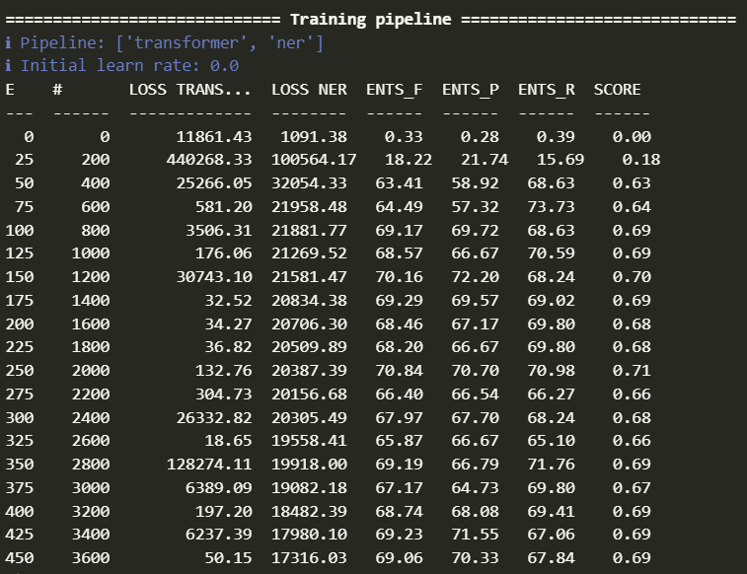
Result
The final score achieved was 0.69. In general, accuracy is not always a good measure of performance for NER models, as the datasets can be highly imbalanced, with many more non-entities than entities. Therefore, F1 score is often used as a more informative evaluation metric for NER models.

Slide 12
Future Scope
expansion into other data formats
Developing a resume parsing system that can handle multiple languages

Slide 13
Reference
[1] Bhor, Shubham, Vivek Gupta, Vishak Nair, Harish Shinde, and Manasi S. Kulkarni. ”Resume parser using natural language processing techniques.” Int. J. Res. Eng. Sci 9, no. 6 (2021).
[2] Bhaliya, Nirali, Jay Gandhi, and Dheeraj Kumar Singh. ”NLP based extraction of relevant resume using machine learning.” (2020).
[3] Das, Papiya, Manjusha Pandey, and Siddharth Swarup Rautaray. ”A CV parser model using entity extraction process and big data tools.” IJ Information Technology and Computer Science 9 (2018): 21-31.
[4] Kudatarkar, Vinaya Ramesh, Manjula Ramannavar, and S. S. Nandini. ”A survey on unstructured text analytics approaches for qualitative evaluation of resumes.” International Journal of Emerging Technology in Computer Science and Electronics (IJETCSE) April 14 (2015).
[5] Sanyal, Satyaki, Souvik Hazra, Soumyashree Adhikary, and Neelanjan Ghosh. ”Resume parser with natural language processing.” International Journal of Engineering Science 4484 (2017).

Slide 14
Thank you.

